Slide 1
Yellow Cab

Slide 2
Purpose
How can Yellow Cab increase revenue and where should they be focusing their efforts?
How can historical data help answer these questions?

Slide 3
Analysis
Looked at frequency, geography, and revenue

Slide 4
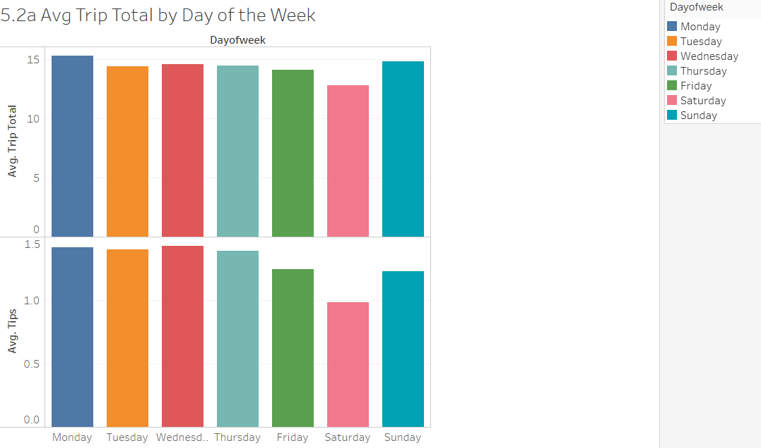
Analysis
Average of Trip Total and average of Tips for each Dayofweek. Color shows details about Dayofweek.
We see the highest trip total on Monday with an average of $15.29 and the lowest on Saturday with an average total of $12.81.
We see the highest average tip on Wednesday and the lowest average tip on Saturday.

Slide 5
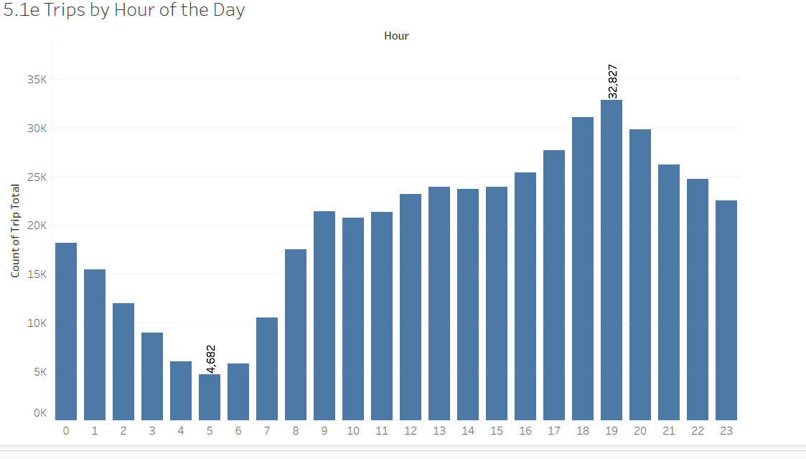
Analysis
Number of trips by hour of the day

Slide 6
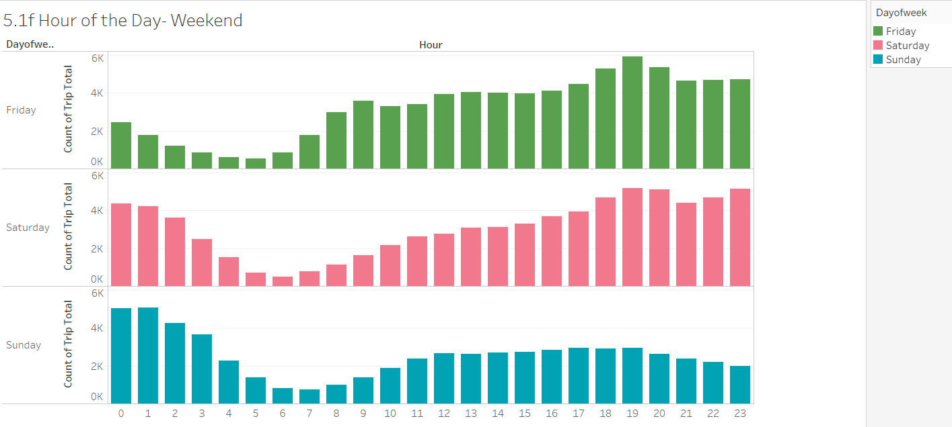
Analysis
Number of trips on weekend by hour of the day
Highest frequency peaks are late evening/early morning

Slide 7
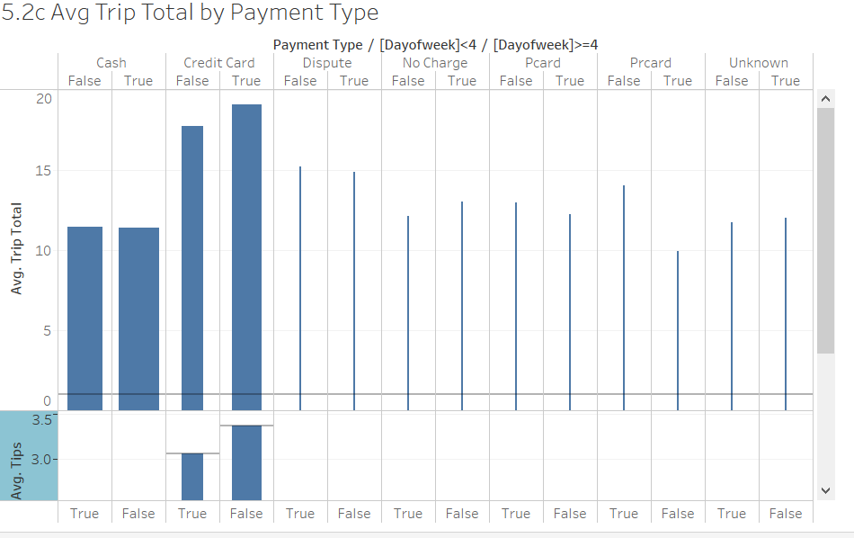
Analysis
From this graph we see that a vast majority of transactions are either cash or credit card. We also see that Credit Card Transactions also have the highest average trip total and tip.
We see more transactions on the weekdays and they also have a higher average trip total and tip per trips by hour of the day

Slide 8
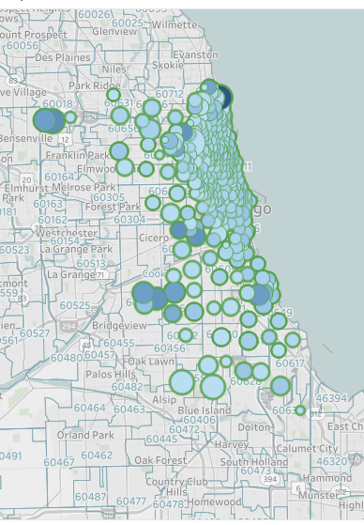
Analysis
Map of trips and tips by Pickup
Size indicates the trip total amount (larger dot = larger trip total)
Color indicates size of tips (darker color = larger tip)

Slide 9
Results & Recommendations
Yellow Cab trips yielded the highest trip totals on Mondays followed by Sundays
Although there was a high frequency of trips on Saturday nights, that day yielded on average the least amount in tips
Pickups from O’Hare International Airport yielded the highest trip totals
Pickups in residential areas had higher trip totals than those in the city center

Slide 10
Results & Recommendations
If not done so already, all Yellow Cabs should be equipped to take credit card payments
If data for rideshare companies is available in the same fashion, Yellow Cab should consider investigating whether mobile/automatic payments have a statistically significant impact on trip totals and trips, all else being equal
Yellow Cab should focus pickups, increasing frequency and amount of cabs focusing on the locations, hours, and days with the highest average trip totals
As expected, there was a high frequency of trips on the weekends in the evening, but based on the average trip totals, these trips where shorter and yielded lower tips

